Slide 1
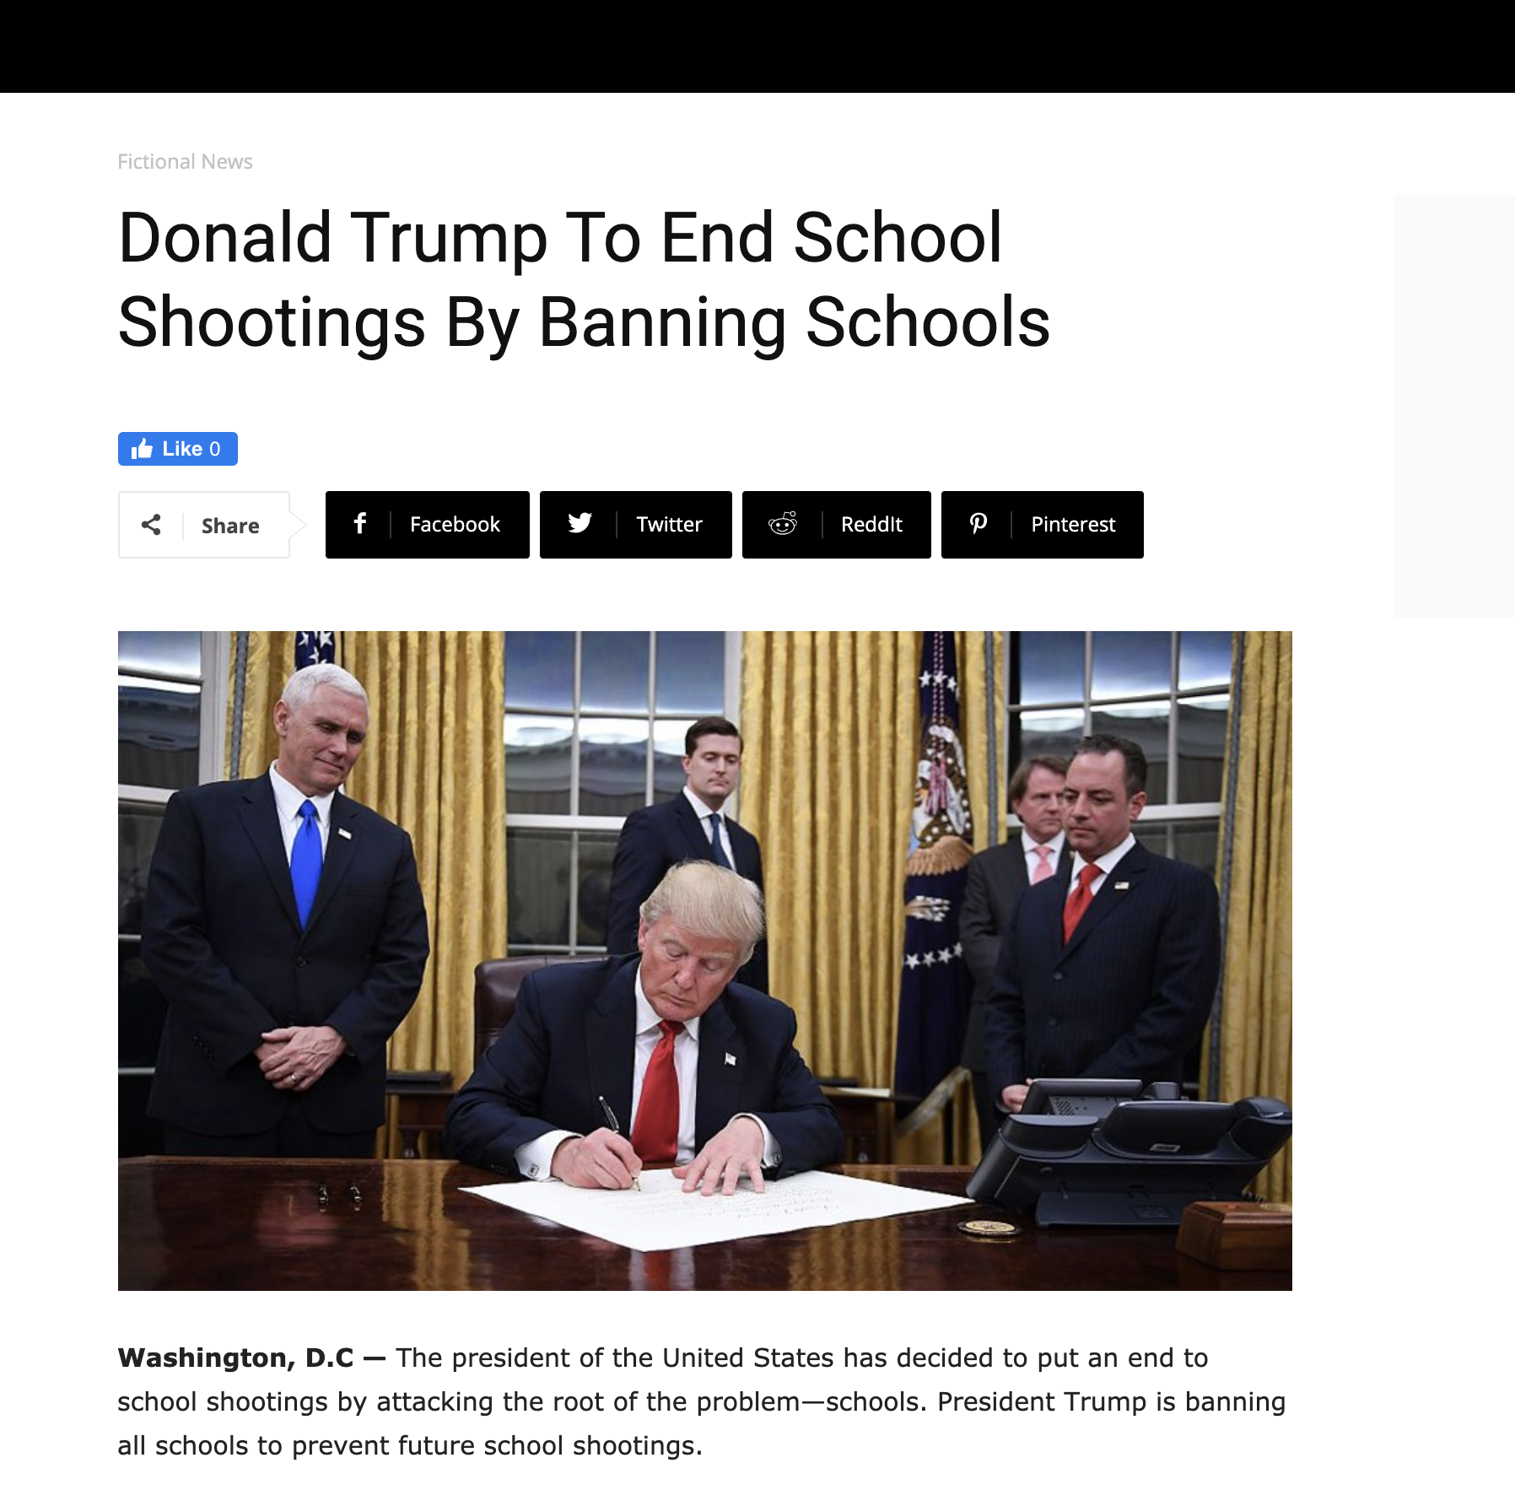

Slide 2
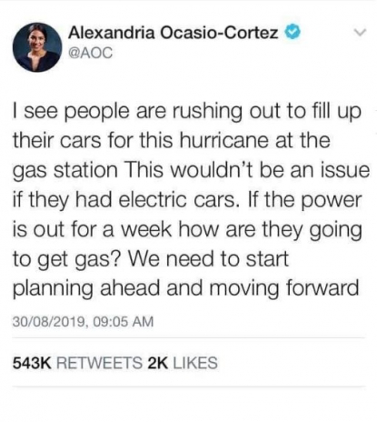
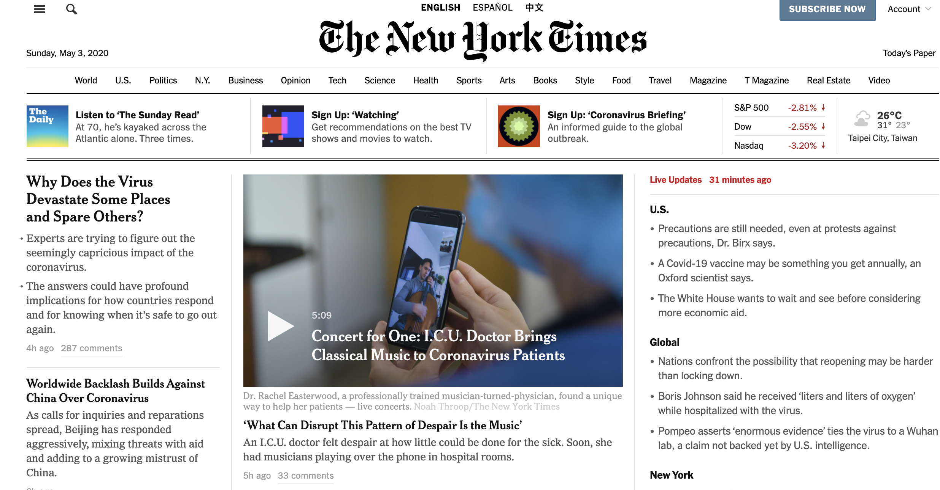
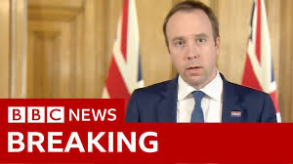
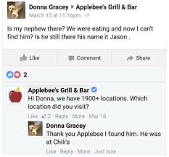
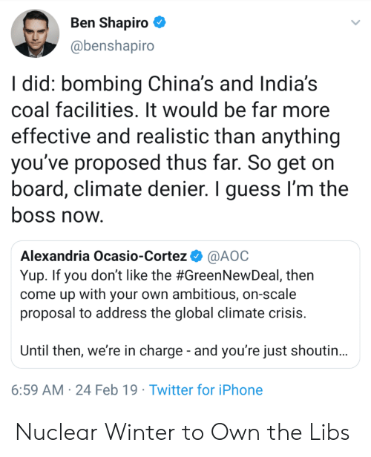
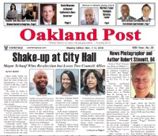
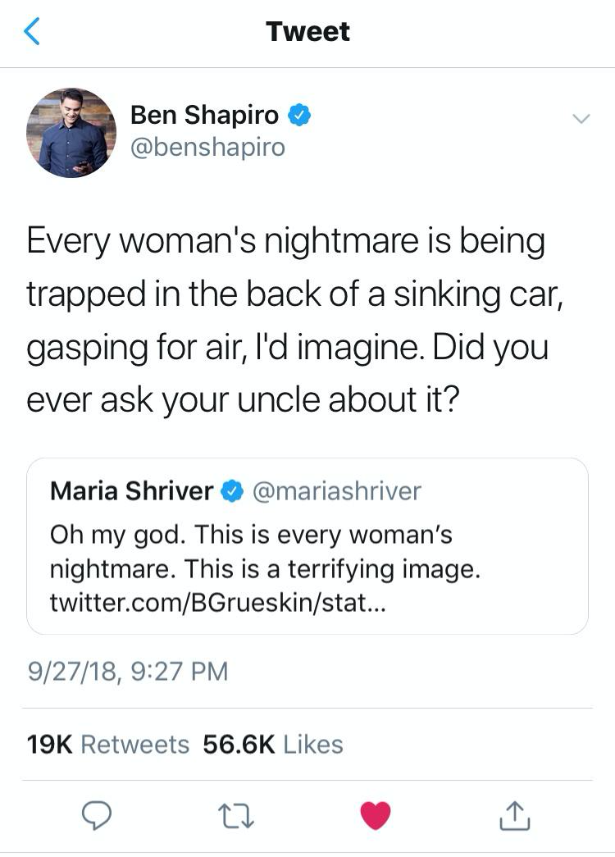
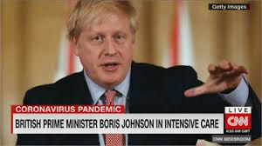
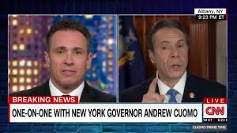
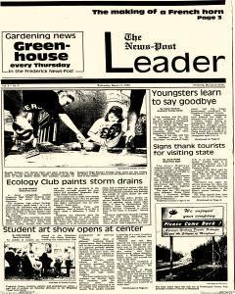
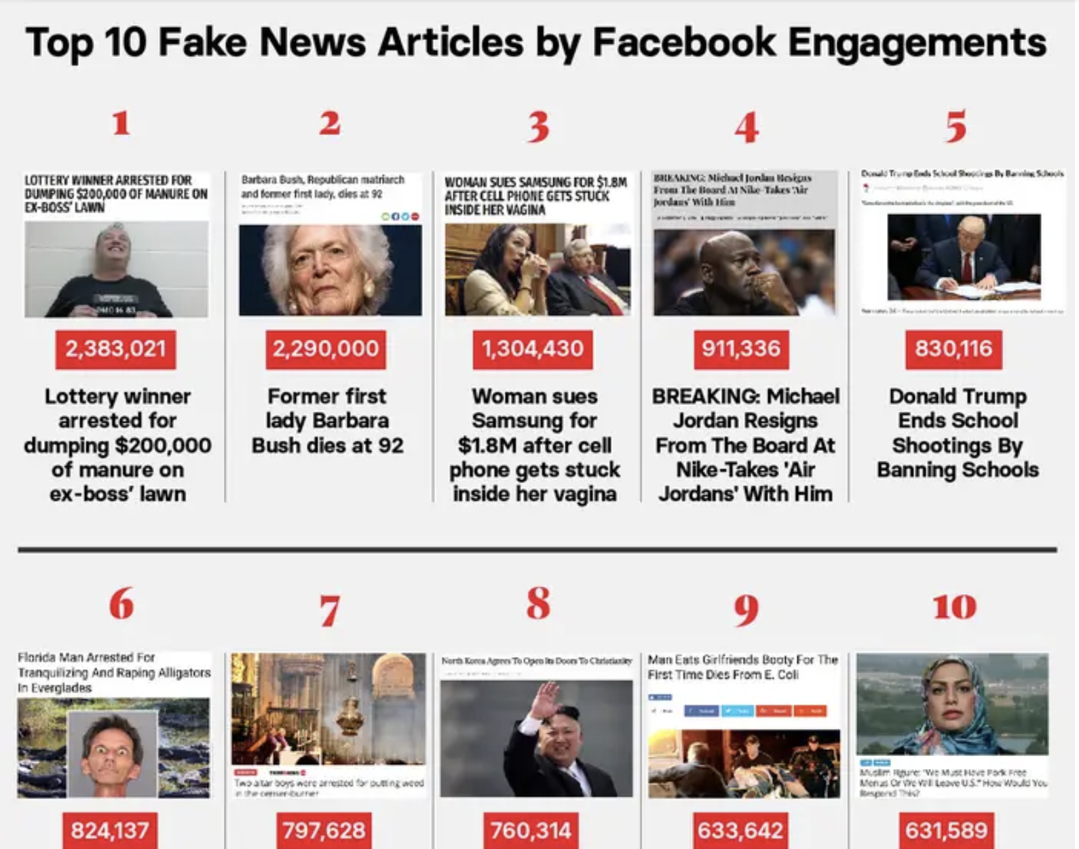
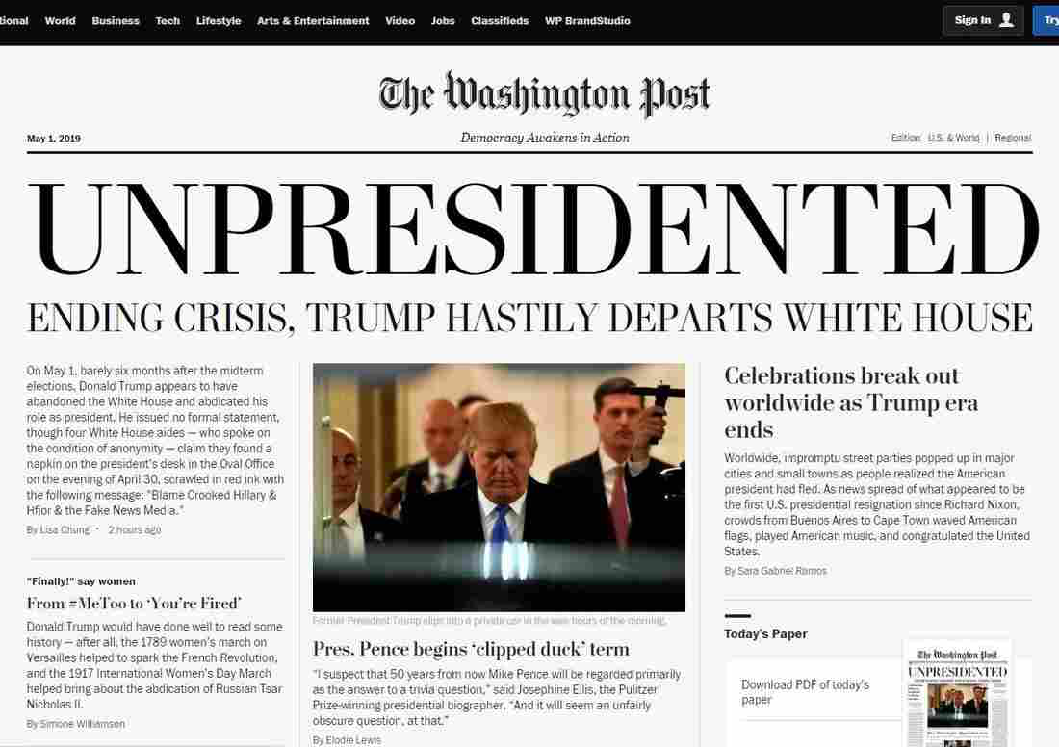

?
Notes:
https://www.npr.org/2019/01/16/685857177/real-fake-news-activists-circulate-counterfeit-editions-of-the-washington-post
https://postnewsgroup.com/
https://newspaperarchive.com/frederick-news-post-leader-mar-11-1992-p-1/

Slide 3


Slide 4
Existing Research

Slide 5
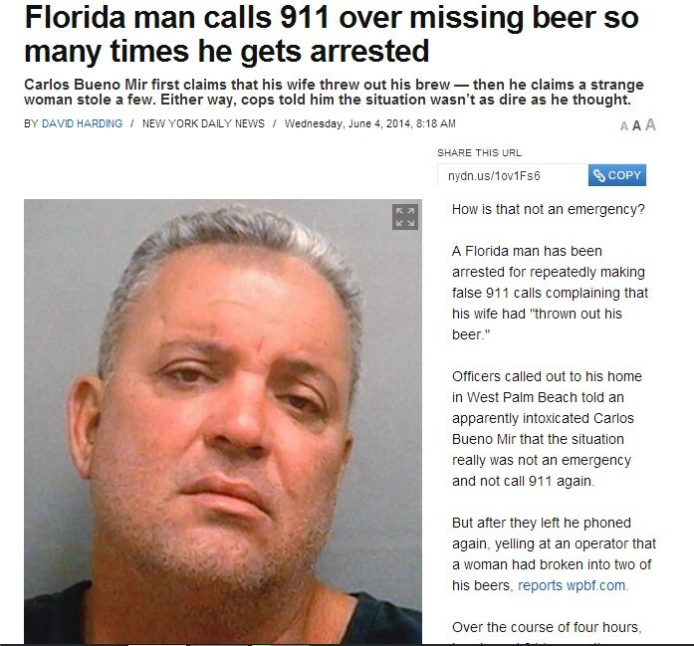


Slide 6
Our Research

Slide 7
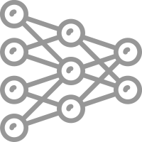
Detection Model
Features

Slide 8
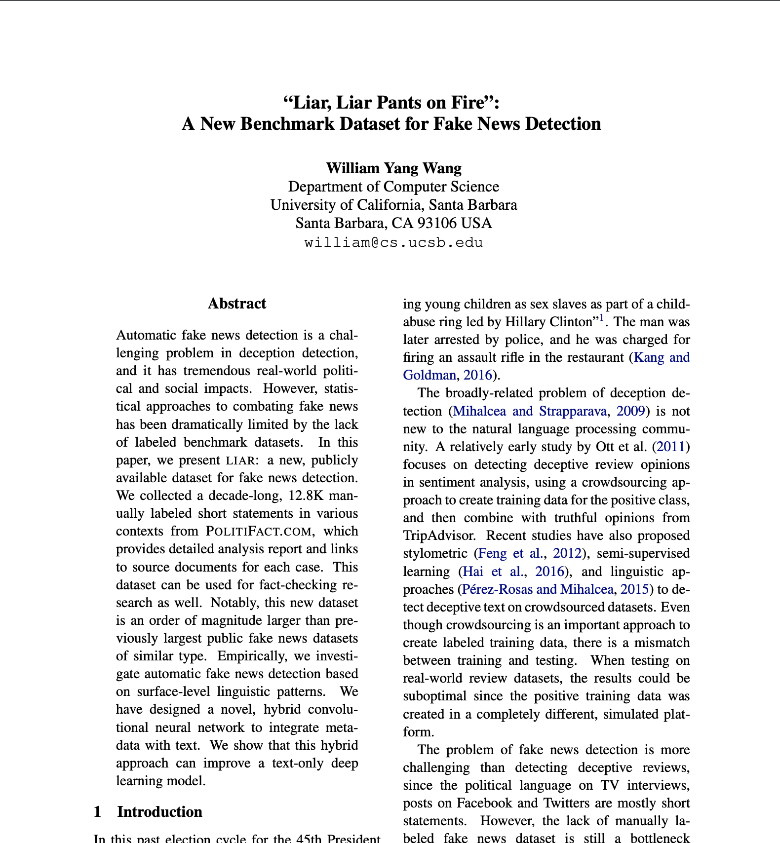
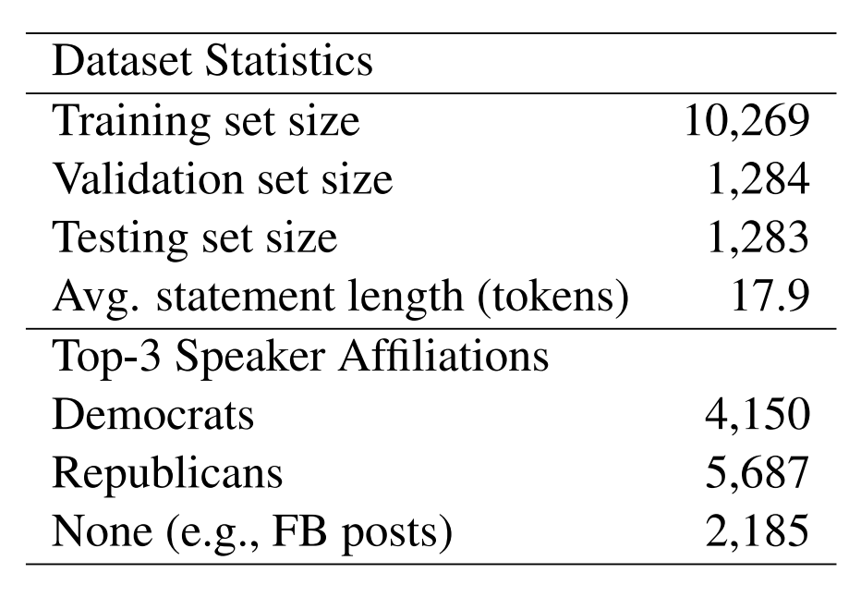
LIAR dataset
2007 - 2016
Subject | Context | State
Speaker | Job Title | Party | Credit
Notes:
https://www.aclweb.org/anthology/P17-2067/

Slide 9
Research Process
CountVectorizer
TfidfVectorizer
Accessing
Dataset
Data
Visualization
Encoding &
Preprocessing
Identify
Important Features
Test
Model
Optimize
Algorithms
Neuron Network
K-nearest Neighbors

Slide 10
Result

Slide 11
Best Accuracies
Test Accuracy
Algorithm | KNN | Neuron
All | 0.1515 | 0.1492
All - Context | 0.1523 | 0.1965
All - Credit | 0.1641 | 0.1618
All - Job title | 0.1586 | 0.1476
All - Party | 0.1555 | 0.1918
All - Speaker | 0.1713 | 0.1736
All - State | 0.1736 | 0.1602
All - Subject | 0.1507 | 0.1634

Slide 12
Color the top three and last three
Test Accuracy
Algorithm | KNN | Neuron
All | 0.1515 | 0.1492
All - Context | 0.1523 | 0.1965
All - Credit | 0.1641 | 0.1618
All - Job title | 0.1586 | 0.1476
All - Party | 0.1555 | 0.1918
All - Speaker | 0.1713 | 0.1736
All - State | 0.1736 | 0.1602
All - Subject | 0.1507 | 0.1634

Slide 13
“All - Speaker” performs well!
Test Accuracy
Algorithm | KNN | Neuron
All | 0.1515 | 0.1492
All - Context | 0.1523 | 0.1965
All - Credit | 0.1641 | 0.1618
All - Job title | 0.1586 | 0.1476
All - Party | 0.1555 | 0.1918
All - Speaker | 0.1713 | 0.1736
All - State | 0.1736 | 0.1602
All - Subject | 0.1507 | 0.1634

Slide 14
Notes:
https://images.app.goo.gl/1aKb6PX8Tya22YV88

Slide 15
Test Accuracy
Algorithm | KNN | Neuron
All | 0.1515 | 0.1492
All - Context | 0.1523 | 0.1965
All - Credit | 0.1641 | 0.1618
All - Job title | 0.1586 | 0.1476
All - Party | 0.1555 | 0.1918
All - Speaker | 0.1713 | 0.1736
All - State | 0.1736 | 0.1602
All - Subject | 0.1507 | 0.1634

Slide 16
 | KNN |  | Neuron
 | Validate | Test | Validate | Test
All | 0.1667 | 0.1515 | 0.2025 | 0.1492
All - Context | 0.1651 | 0.1523 | 0.1550 | 0.1965
All - credit | 0.1783 | 0.1641 | 0.2033 | 0.1618
All - Job title | 0.1651 | 0.1586 | 0.1503 | 0.1476
All - Party | 0.1659 | 0.1555 | 0.1604 | 0.1918
All - Speaker | 0.1729 | 0.1713 | 0.1480 | 0.1736
All - State | 0.1682 | 0.1736 | 0.1495 | 0.1602
All - Subject | 0.1643 | 0.1507 | 0.1519 | 0.1634

Slide 17
Validate
Test
 | KNN | Neuron
All | 0.1667 | 0.2025
All - Context | 0.1651 | 0.1550
All - Credit | 0.1783 | 0.2033
All - Job title | 0.1651 | 0.1503
All - Party | 0.1659 | 0.1604
All - Speaker | 0.1729 | 0.1480
All - State | 0.1682 | 0.1495
All - Subject | 0.1643 | 0.1519
 | KNN | Neuron
All | 0.1515 | 0.1492
All - Context | 0.1523 | 0.1965
All - credit | 0.1641 | 0.1618
All - Job title | 0.1586 | 0.1476
All - Party | 0.1555 | 0.1918
All - Speaker | 0.1713 | 0.1736
All - State | 0.1736 | 0.1602
All - Subject | 0.1507 | 0.1634

Slide 18
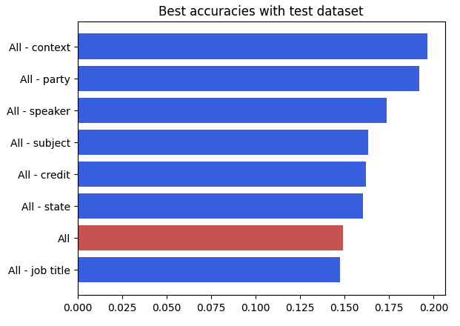
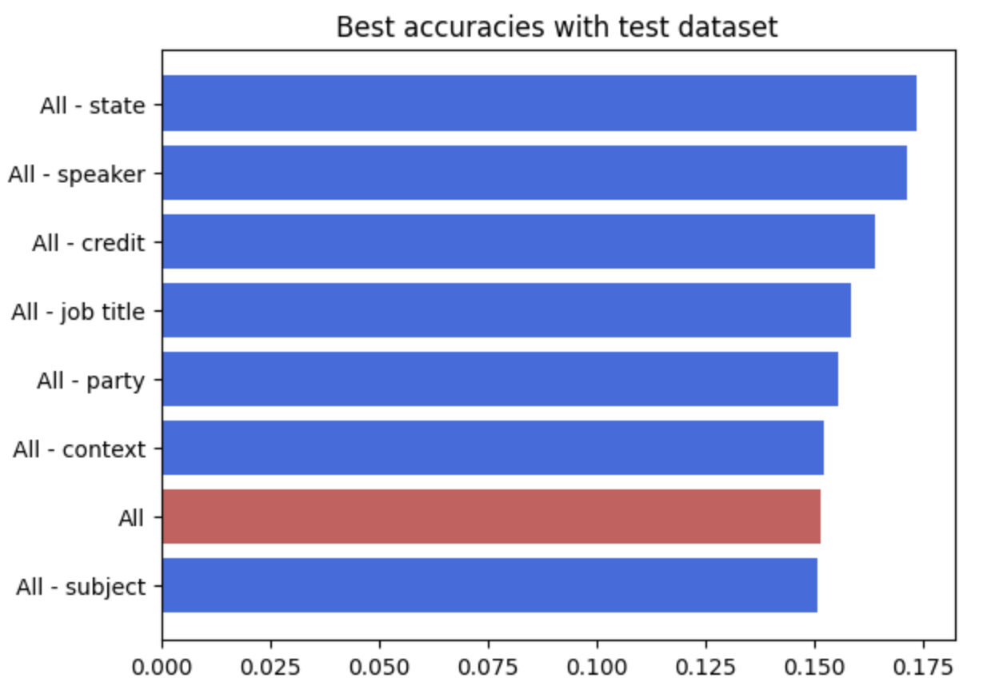
Neuron
KNN

